Slide 2
Growsmarter
measure 7.1-7.3
Hans Anebreid
hans.anebreid@envac.se
2018-10-04

Slide 3
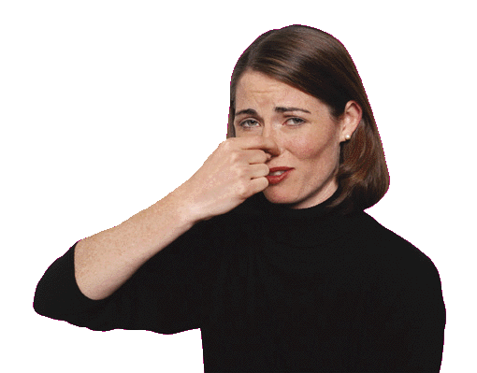
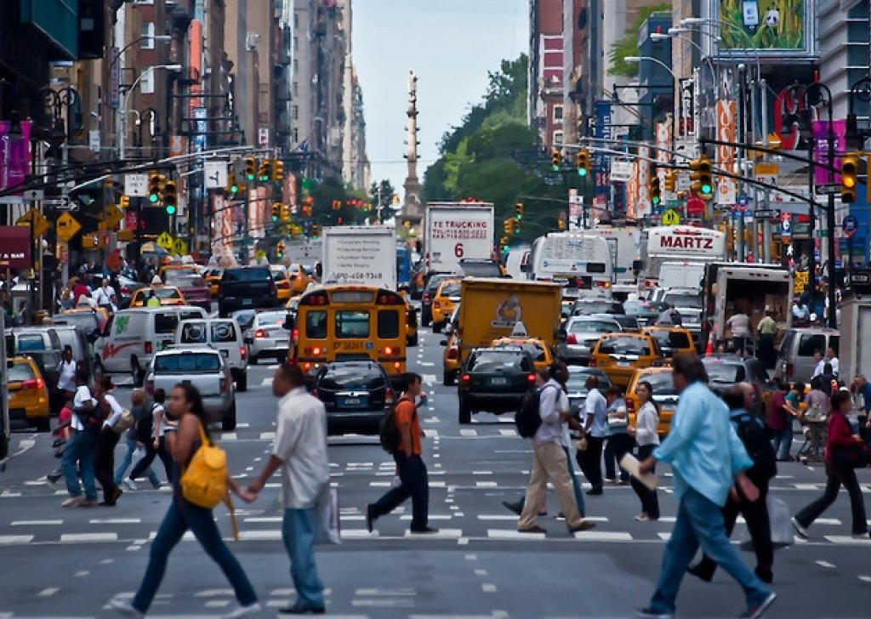
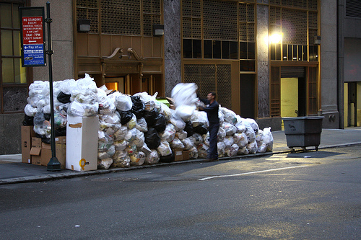
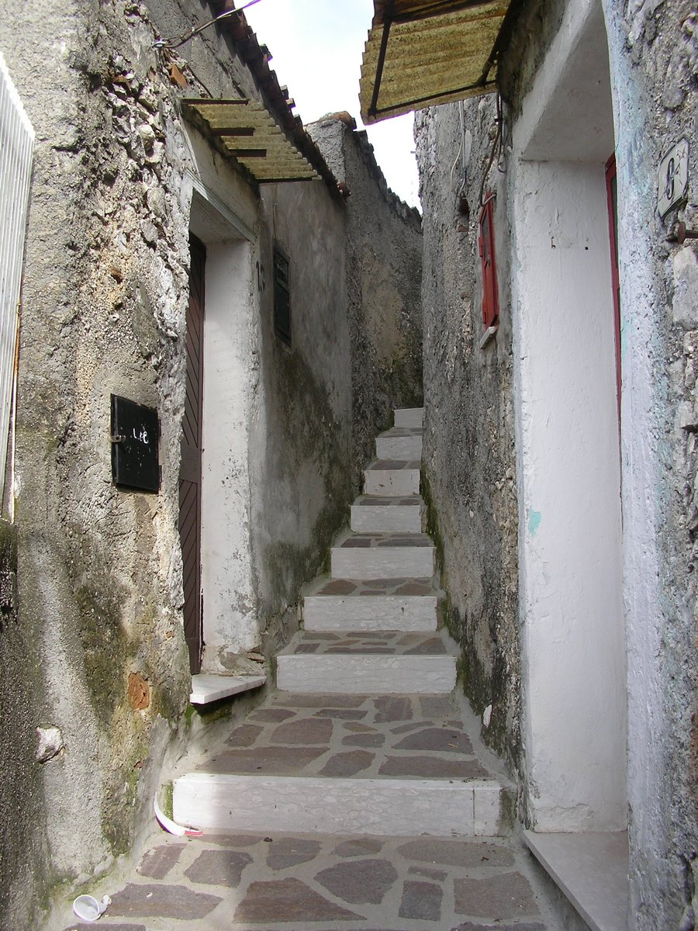
The city waste management challenge!!
Hans Anebreid
Rats
Space
Smell
Traffic
Increased amounts of waste
Need to recycle

Slide 4
Envac Growsmarter
Measure 7.1
Optical sorting of waste
Measure 7.2
Automated Waste Collection
Measure 7.3
Waste collection statistics
Recycling made easy
Hans Anebreid

Slide 5
Some history
Envac is the inventor of the vacuum waste collection technology.
Our oldest running system is from 1961 – the very first system in the world in operation (Sollefteå Hospital, Sweden)
Since then we have installed 1,000+ systems worldwide
Hans Anebreid

Slide 6
Organisation overview and Key figures 2016
Envac AB | 2016 | 2017
Order intake MSEK | 1,279 | 1,558
EBIT MSEK | 81 | 88
Number of employees, average | ~650 | ~650
The Stena Sphere 2016 (in MSEK)
Total revenue | 50,950
Profit before tax | 7,195
No of Employees | 19,000
Dan Sten Olsson
CEO Stena AB
Hans Anebreid
6

Slide 7
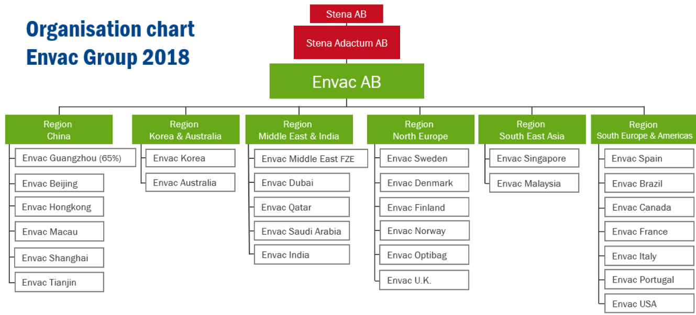
Hans Anebreid

Slide 8
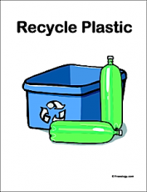
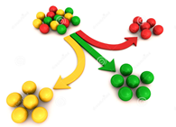
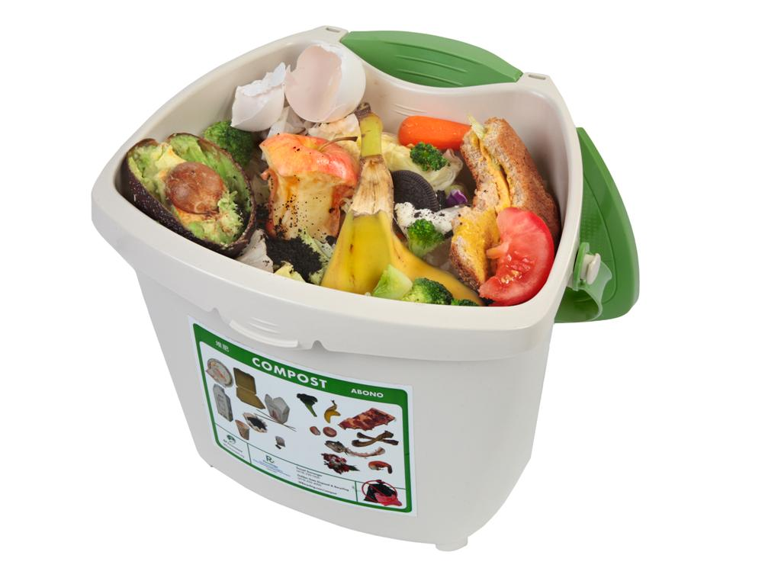
The value chain of waste – Envac in the context
Hans Anebreid

Slide 9
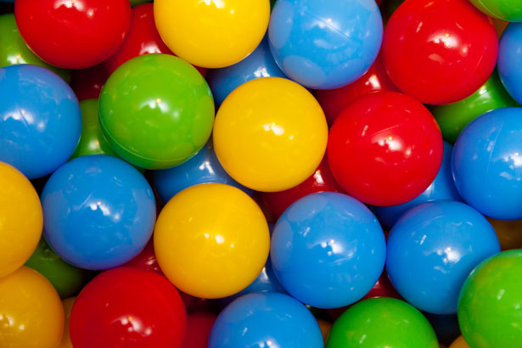
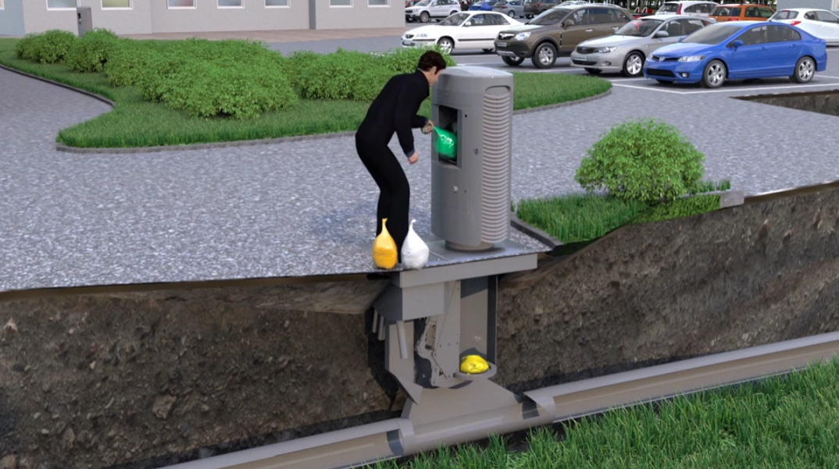
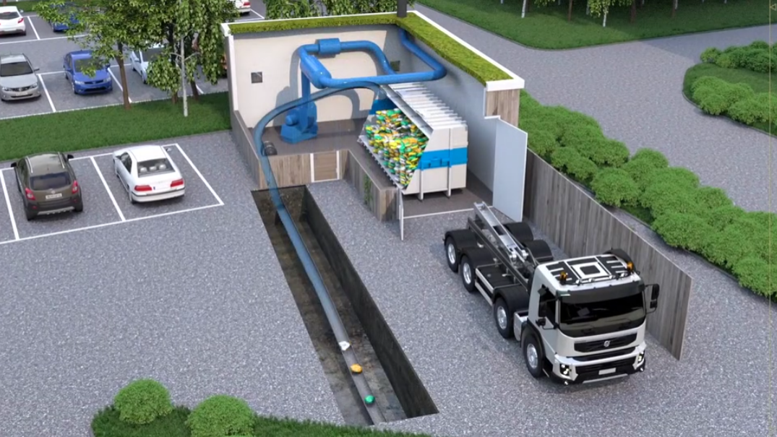
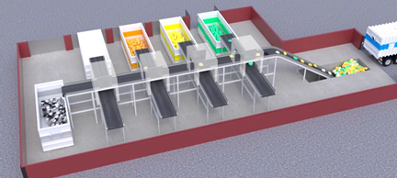
The value chain of waste – Envac in the context
https://vimeo.com/237059293
Hans Anebreid

Slide 10
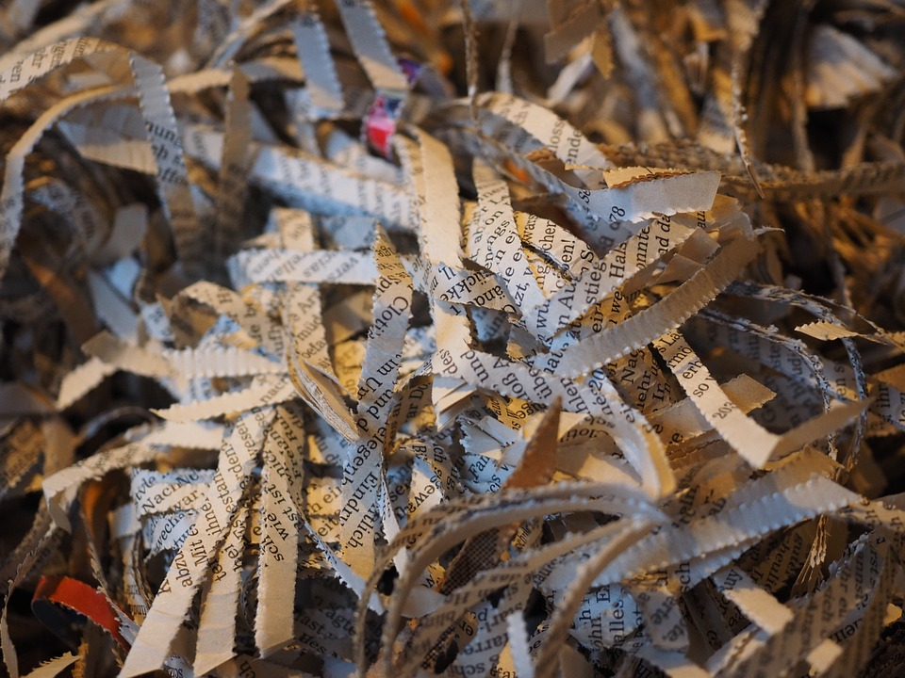
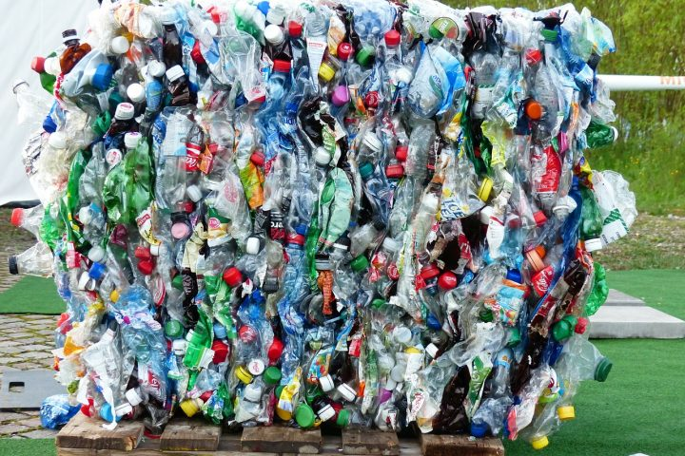
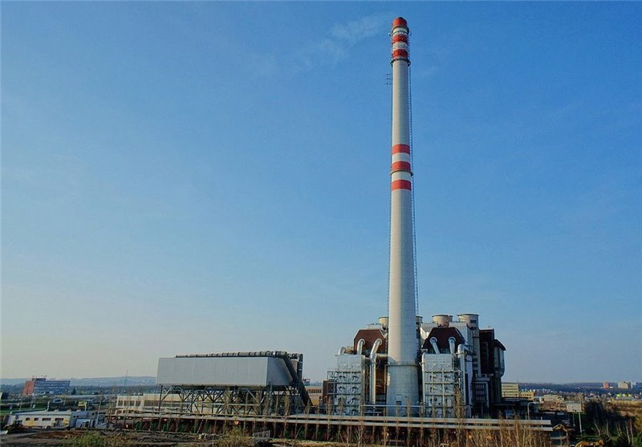
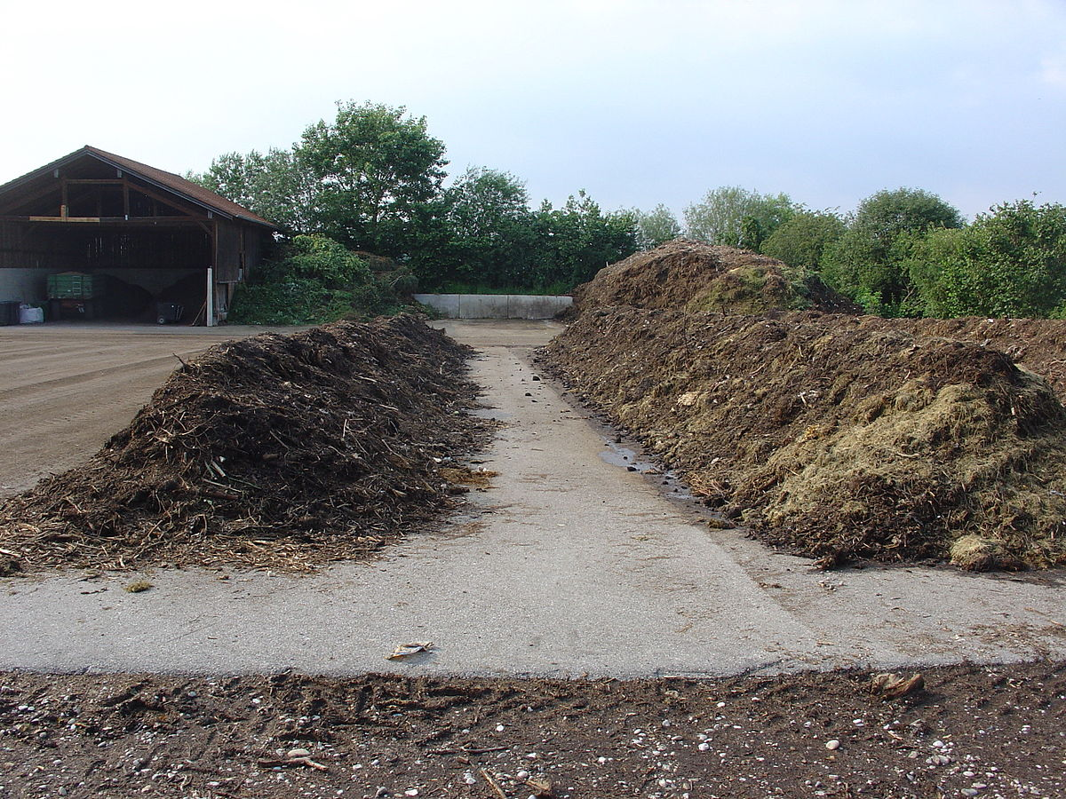
Waste handling after optical sorting…
Hans Anebreid

Slide 11
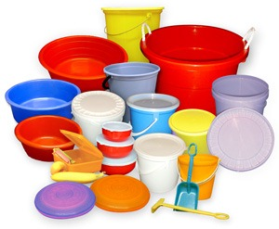
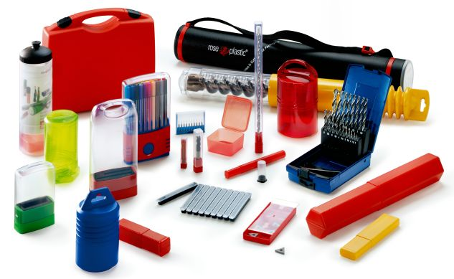
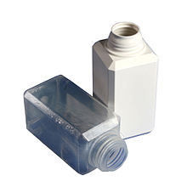
Waste handling after optical sorting…
Hans Anebreid

Slide 12
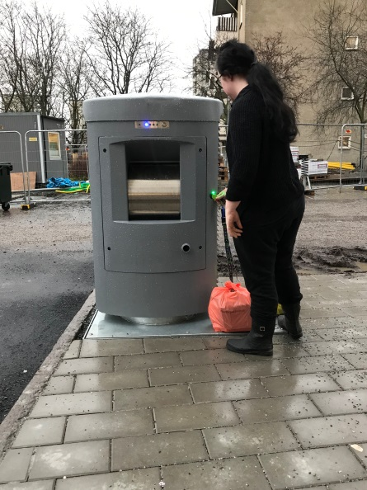
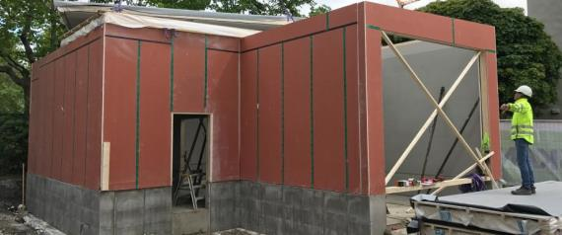
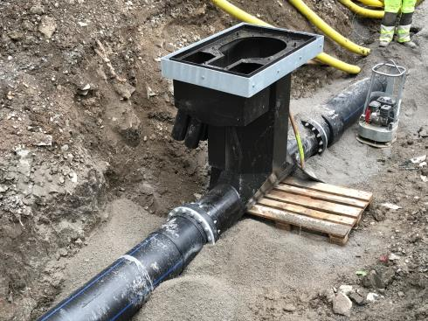
Implementation – Envac point of view
Challenging parts
New type of inlet, color reader and weighing system
New pipe material, includes joints, installation, and procurement
New control system
Solutions
Investment in R&D
Add time for sourcing, planning and coordination
Add time for commissioning and follow up
40-50 apartments, sorting of 4 fractions, occupies less than 1 m2.
Hans Anebreid

Slide 13
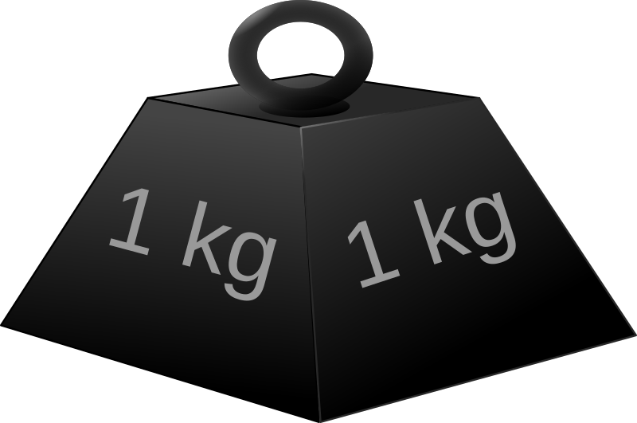
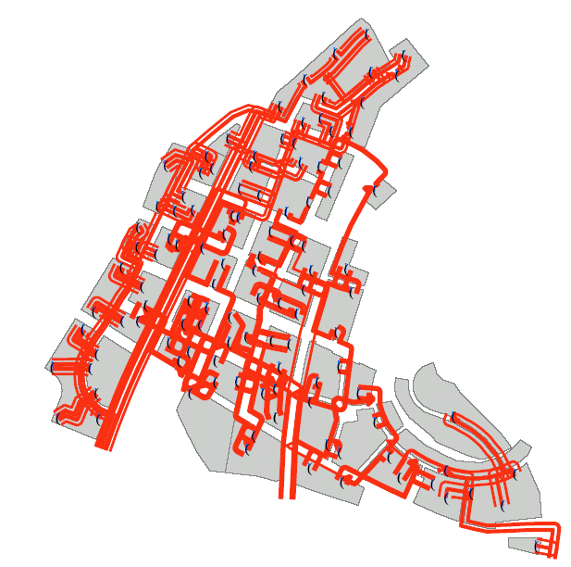
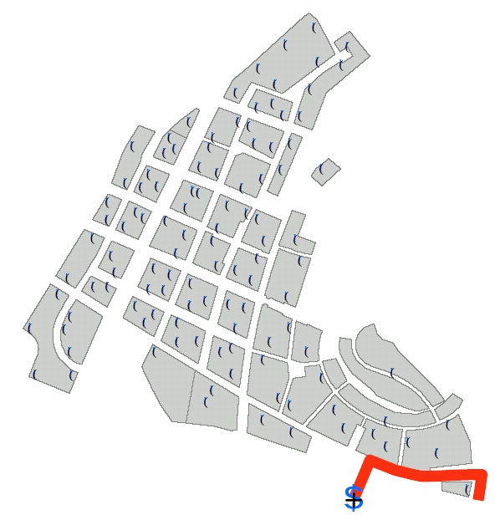
Evaluation
Measure 7.1
Optical sorting of waste
Compare before and after. Amount of sorted waste. Ease of recycling.
Measure 7.2
Automated Waste Collection
Environmental impact before and after. Driving distance in the area.
Measure 7.3
Waste collection statistics
Introduce an incentive system to entice residents to improve recycling. E.g. web, mail and/or app.
Evaluation
Data base analysis. Weight and color
Questionairre/interviews with tenants
Evaluation
Measure driving distance
Calculate environmental impact
Adjust for project specific requirements
Evaluation
Develop incentive system
Feedback to users
Evaluate
Hans Anebreid

Slide 14
Evaluation – Data 180618 -- 180821
Hans Anebreid

Slide 15
Evaluation – Data 180618 -- 180821 [kg/apartment/day]
Hans Anebreid

Slide 16
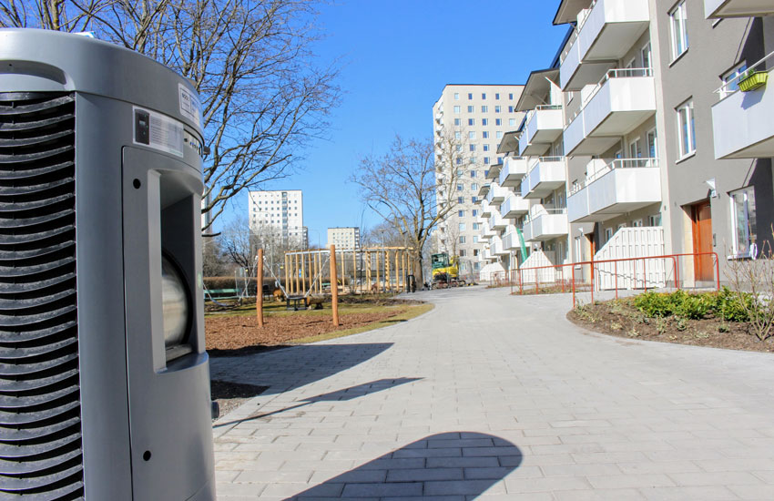
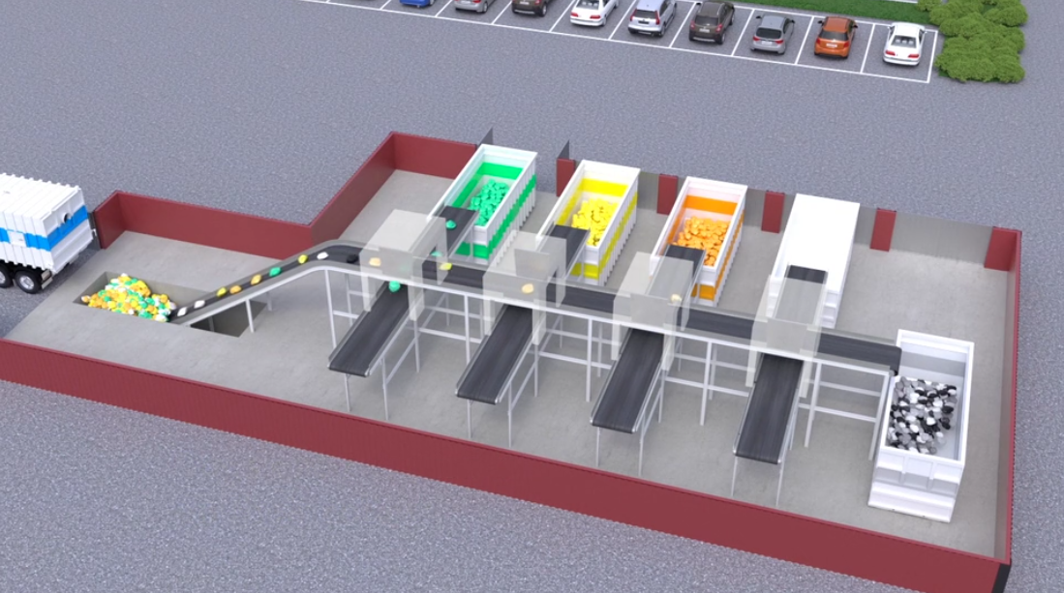
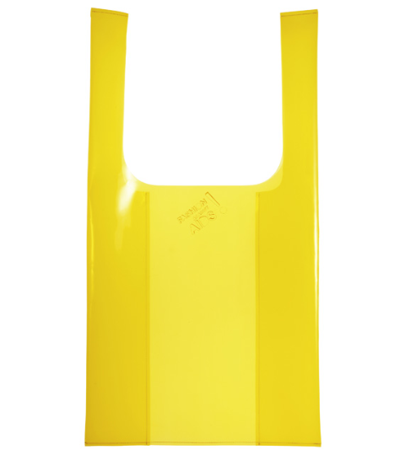
Stakeholders – Stockholm site
Multiple sub and side contractors for installation
Hans Anebreid

Slide 17
Conclusions (early ones…)
Reduced traffic
Investment needed from the city (sorting facility)
Good sorting rates so far
Less space occupied for waste handling
Upscaling from 350 appartments will require further analysis on operation schedule
Hans Anebreid

